Slide 1
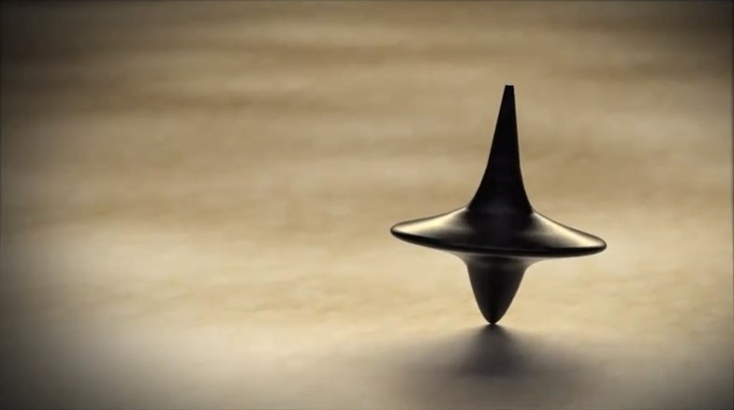

Perception
ORGB1500 - Organizational Behaviour for Media and IT - Ed Beerwart

Slide 2

Perception
Content
Perception
Perceptual Process Model
Stimuli
Sensation
Meaning
Perceptual Errors
Primacy Error
Recency Error
Halo Effect
False Consensus
Elements of Self-concept
Self-esteem
Self-efficacy
Locus of control
Social Identity Theory
Self-fulfilling Prophecy

Slide 3
Perception

Slide 4
Perception
R
U
“
The process or result of becoming aware of objects, relationships, and events by means of the sense, which includes such activities as recognizing, observing, and discriminating.
The activities enable organisms to organize and interpret the stimuli received into meaningful knowledge.
”
VandenBos, G. R. (Ed.). (2007). APA Dictionary of Psychology. Washington, DC, US: American Psychological Association.

Slide 5
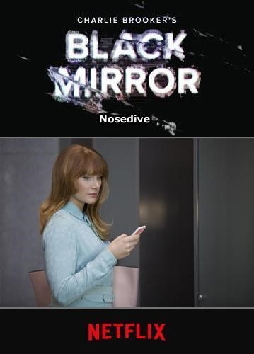



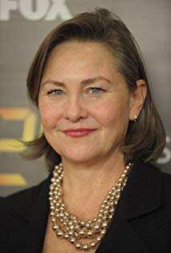
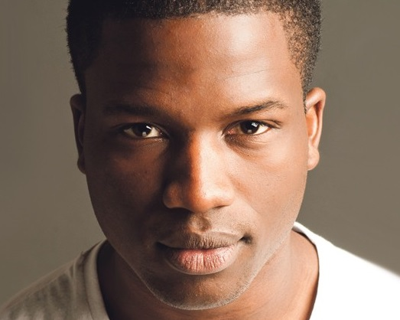
Perception example
Ap
Black Mirror
Season 3 Episode 1
“Nosedive”
(63 mins)
A woman desperate to boost her social media score hits the jackpot when she's invited to a swanky wedding, but the trip doesn't go as planned.
Lacie
Pound
Ryan
Pound
Naomi
Blestow
Susan
Prisoner

Slide 6
Perceptual Process Model

Slide 7
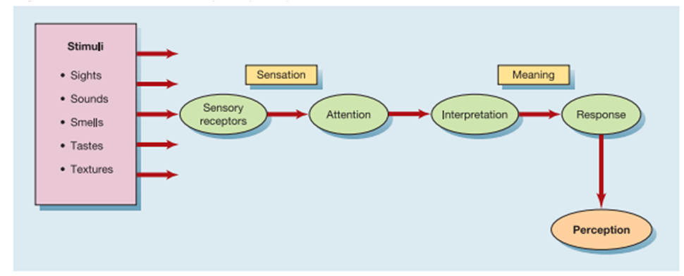
Perceptual Process Model
R
U

Slide 8
Perceptual Process Model - Stimuli
Ap
An
What is the most pleasant experience in each stimuli?
What is the least pleasant?

Slide 9
Perceptual Process Model - Sensation
Ap
An
Our eyes, ears, nose, tongue, and skin are our primary sensory receptors.
We pay most of our attention to things that are unique, very pleasant, or very unpleasant.

Slide 10
Perceptual Process Model - Meaning
Ap
An
Different interpretations or stimuli lead to different responses. The herb cilantro invokes different responses in different people.

Slide 11
Perceptual Errors

Slide 12
Primacy Error
R
U
“
The tendency for facts, impressions, or items that are presented first to be better learned or remembered than material presented later in the sequence.
This can occur in both formal learning situations and social contexts.
For example, it can result in a First-Impression Bias, in which the first information gained about a person has an inordinate influence on later impressions and evaluations of that person.
”
VandenBos, G. R. (Ed.). (2007). APA Dictionary of Psychology. Washington, DC, US: American Psychological Association.

Slide 13
Primacy Error
Ap
An
Which characters were judged according to the primacy effect?
Lacie
Pound
Ryan
Pound
Naomi
Blestow
Susan
Prisoner

Slide 14
Recency Error
R
U
“
A memory phenomenon in which the most recently presented facts, impressions, or items are learned or remembered better than material presented earlier.
This can occur in both formal learning situations and social contexts.
For example, it can result in inaccurate ratings or impressions of a person’ abilities or other characteristics due to the inordinate influence of the most recent information received about that person.
”
VandenBos, G. R. (Ed.). (2007). APA Dictionary of Psychology. Washington, DC, US: American Psychological Association.

Slide 15
Recency Error
Ap
An
Which characters were judged according to the recency effect?
Lacie
Pound
Ryan
Pound
Naomi
Blestow
Susan
Prisoner

Slide 16
Halo Effect
R
U
“
The tendency for a general evaluation of a person, or an evaluation of a person on a specific dimension, to be used as a basis for judgments of that person on other specific dimensions.
For example, a person who is generally liked might be judged as more intelligent, competent, and honest than a person who is generally disliked.
”
VandenBos, G. R. (Ed.). (2007). APA Dictionary of Psychology. Washington, DC, US: American Psychological Association.

Slide 17
Halo Effect
Ap
An
Which characters were judged according the the halo effect?
Lacie
Pound
Ryan
Pound
Naomi
Blestow
Susan
Prisoner

Slide 18
False Consensus
R
U
“
An opinion or belief that is mistakenly thought to be held by all or nearly all the people in a given group, whereas in fact there is significant dissent.
”
VandenBos, G. R. (Ed.). (2007). APA Dictionary of Psychology. Washington, DC, US: American Psychological Association.

Slide 19
False Consensus
Ap
An
Which characters display the perceptual error of false consensus?
Lacie
Pound
Ryan
Pound
Naomi
Blestow
Susan
Prisoner

Slide 20
Elements of Self-concept

Slide 21
Self-esteem
R
U
The degree to which the qualities and characteristics contained in one’s self-concept are perceived to be positive. It reflects a persona’s physical self-image, view of his or her accomplishments and capabilities, and values and perceived success in living up to them, as well as the ways in which others view and respond to the person.
The more positive the cumulative perception of these qualities and characteristics, the higher one’s self-esteem.
A high or reasonable degree of self-esteem is considered an important ingredient of mental health, whereas low self-esteem and feelings of worthlessness are common depressive symptoms.
“
”
VandenBos, G. R. (Ed.). (2007). APA Dictionary of Psychology. Washington, DC, US: American Psychological Association.

Slide 22
Self-esteem
Ap
An
Which of the characters had high/low self-esteem?
Did it change throughout the episode?
Lacie
Pound
Ryan
Pound
Naomi
Blestow
Susan
Prisoner

Slide 23
Self-efficacy
R
U
“
An individual’s effectively to bring about desired results, escapacity to act pecially as perceived by the individual.
”
VandenBos, G. R. (Ed.). (2007). APA Dictionary of Psychology. Washington, DC, US: American Psychological Association.

Slide 24
Self-efficacy
Ap
An
Which of the characters had high/low self-efficacy?
Did it change throughout the episode?
Lacie
Pound
Ryan
Pound
Naomi
Blestow
Susan
Prisoner

Slide 25
Locus of Control
R
U
“
A construct that is used to categorize people’s basic motivational orientations and perceptions of how much control they have over the conditions of their lives.
People with an external locus of control tend to behave in response to external circumstances and to perceive their life outcomes a arising from factors out of their control.
People with an internal locus of control tend to behave in response to internal states of intentions and to perceive their life outcomes as arising from the exercise of their own agency and abilities.
”
VandenBos, G. R. (Ed.). (2007). APA Dictionary of Psychology. Washington, DC, US: American Psychological Association.

Slide 26
Locus of Control
Ap
An
Which characters had an external locus of control? Internal locus of control?
Lacie
Pound
Ryan
Pound
Naomi
Blestow
Susan
Prisoner

Slide 27
Social Identity Theory
R
U
“
A general social-psychological conceptualization of the personal and interpersonal factors that influence the publicly claimed and presented self.
Also, a conceptual perspective on group processes and intergroup relations that assumes that groups influence their members’ self-concepts and self-esteem, particularly when individuals categorize themselves as group members and identify strongly with the group.
According to this theory, people tend to favour their ingroup over an outgroup because the former is part of their self-identity.
”
VandenBos, G. R. (Ed.). (2007). APA Dictionary of Psychology. Washington, DC, US: American Psychological Association.

Slide 28
Social Identity Theory
Ap
An
How would the characters socially identify themselves?
Lacie
Pound
Ryan
Pound
Naomi
Blestow
Susan
Prisoner

Slide 29
Self-fulfilling Prophecy
R
U
“
A belief or expectation that helps to bring about its own fulfillment, as, for example, when a person expects nervousness to impair his or her performance in a job interview or when a teacher’s preconceptions about a student’s ability influence the child’s achievement for better or worse.
”
VandenBos, G. R. (Ed.). (2007). APA Dictionary of Psychology. Washington, DC, US: American Psychological Association.

Slide 30
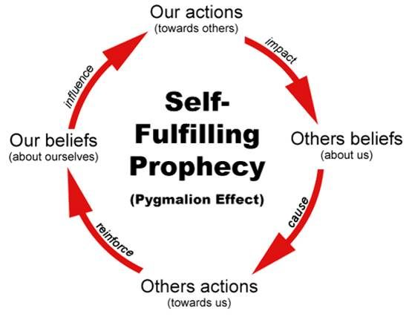
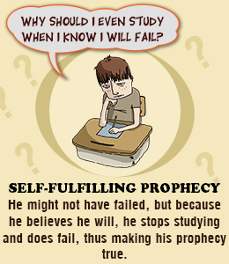
Self-fulfilling Prophecy

Slide 31
Video links
Americans eat Surstromming (4 mins)
https://www.youtube.com/watch?v=_haw_YDC_zo
You Will Be Amazed By These 10 Optical Illusions (12 mins)
https://www.youtube.com/watch?v=YuB81P7i1n4

Slide 32

Thank You
ebeerwart@nait.ca

